Slide 1
Overview and applications of the NanoString nCounter Platform
Paul Rasmussen
Director of Asia Pacific Region
prasmussen@nanostring.com

Slide 2
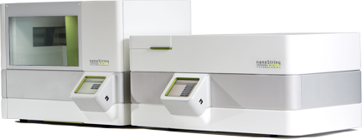
Agenda
Platform Introduction
Assay Overview
Performance
Application extensions
  Single cell / small sample profiling
  miRNA
  DNA applications (CNV and ChIP)

Slide 3
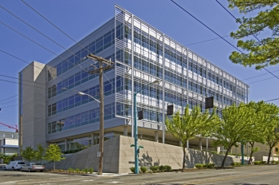

History of NanoString Technologies : who are we ?
2003: Founded as a privately held provider of life sciences tools
  Translational research
  Molecular diagnostics
2008: Launched first commercial instrument system and began international sales operations with its first multiplexed assays for gene expression analysis
2010: Licensed PAM50 for commercial development
2012: Obtained a CE Mark for Diagnostic Assay
Notes:
Who are we, What is the unique technology Nanostring has developed, why is it of interest for us today, what breakthrough does it permits

Slide 4
NanoString nCounter assay: Single reaction, up to 800 targets
QPCR
NanoString
Sensitivity
Microarrays/NGS
1 10 100 1000 10,000
Multiplexing # of Transcripts
Notes:
4
The NanoString nCounter assay provides sensitivity similar to qPCR, with the flexibility to profile 10s or 100s of genes in a single, simple, optimization free assay.
The platform is ideal for workflows where entire pathways, signatures, or other gene sets need to be profiled 10s to 1000s of samples, but where microarray data quality is insufficient, and RNA sequencing are overly complex, cumbersome, or expensive.
800 plex is also a natural fit for miRNA profiling.

Slide 5


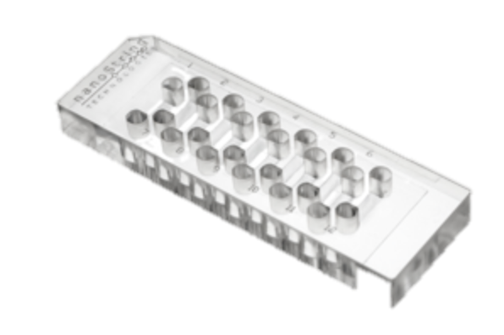



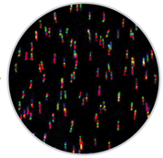
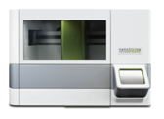
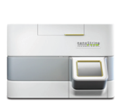
nCounter® technology Key Advantages
No Amplification
Use cell lysates, or FFPE samples
Highly Multiplexed
Up to 800 targets on a single sample at once (no splitting)
Precision
Digital counting
highly reproducibility
Simple and Fast
Easy, fast, automated data production
Simple Data Analysis
Easy automated normalization
Notes:
Beyond multiplexing, the assay has many other advantages.
Workflow is identical (3 pipetting steps per sample), regardless of the plex
Digital counting means very high precision, similar to RNAseq, but with much simpler workflow and analysis
Gene Expression, CNV, and miRNA profiling without any amplification or reverse transcription. Note: People amplify because the HAVE to (we do unabashedly in single cell) , not because they want to…

Slide 6
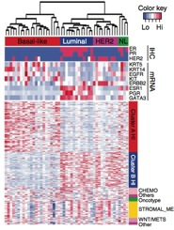
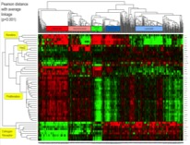

Flexible platform: 20 to 800 genes, 10s to 1000s of samples
^{Knockdown}
^{Response}
^{Medulloblastoma signature}
NanoString PAM50
(Breast Cancer Prognostic)
2011 TransATAC Clinical Trial
^{Drug Resistance}
Northcott P. et al, 2012, Nature
Guttman M. et al, 2011, NAture
BalkoJ. et al, 2012, Nature Medicine
22 Genes
50 Genes
95 Genes
354 Genes
Notes:
Unlike other mid density platforms, the nCounter system is scalable from 20 genes up to 800. The means you’re not making a compromise between format and information content by trying to fit signatures into exactly 24, 48, 96, etc… target formats.

Slide 7
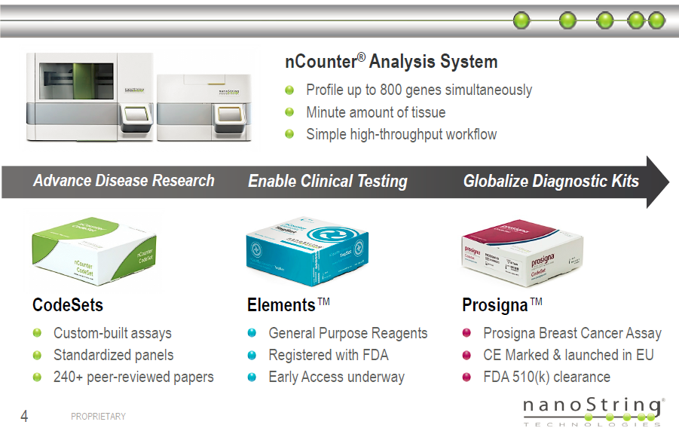
nCounter Technology: ideal for translational research. All endpoints
Notes:
gary

Slide 8
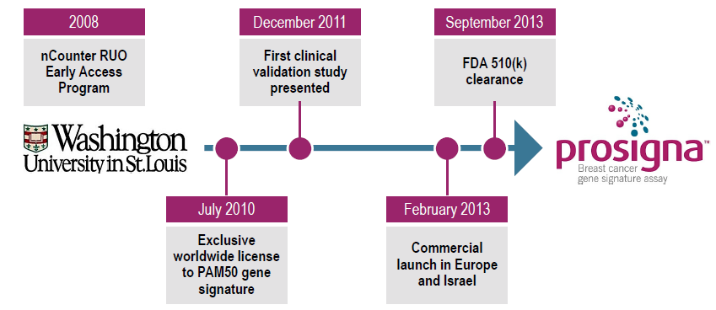

Prosigna: 3348 FFPE samples, two clinical studies, FDA submission, FDA review, FDA acceptance, all in 1008 business days.
1008 business days…
For FDA approval, Net number of FFPE samples examined:
514 for initial signature training, 200 for testing of training process, 1014 for 2011 clinical study #1, 1620 for 2012 clinical study #2
3348 total FFPE samples examined to develop signature.
Notes:
[75]

Slide 9
Agenda
Platform Introduction
Assay Overview
Performance
Application extensions
  Single cell / small sample profiling
  miRNA
  DNA applications (CNV and ChIP)

Slide 10

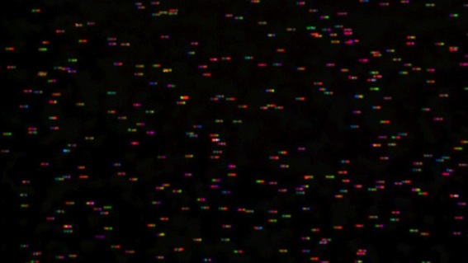
Each Barcode Attached to an Individual RNA
Notes:
10

Slide 11
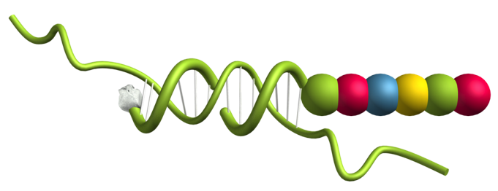
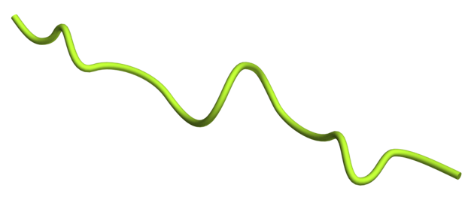
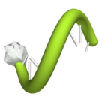
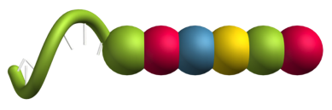
Two probe assay
Both probes are gene specific
Target Specific Capture Probe
Target Specific Reporter Probe
Notes:
11

Slide 12
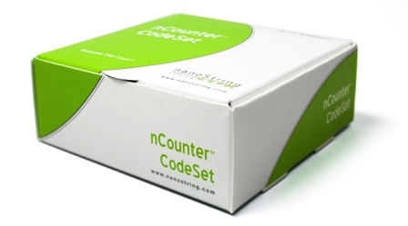
nCounter custom CodeSets
Choose your genes
Premade kits also available
No optimization
Capture Probes
System Controls
Reporter Probes
Notes:
12
Target specific Capture probes and reporter probes are combined to create your custom CodeSet. To reiterate, NanoString builds the barcodes and assigns each gene sequence a unique barcode. Your CodeSet can contain target specific capture and reporter combinations sufficient for 20-800 genes of your choice in a single tube. Both capture probes and reporter probes are in excess to drive the hybridization reaction to completion.
Each CodeSet is synthesized with dozens of internal controls included that allow for assessing the performance of each step in the process and for quantification of your endogenous transcripts. There is no need to waste extra reagents or sample material running extra controls like you would have to using qPCR, they are already included in each codeset.

Slide 13
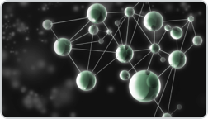
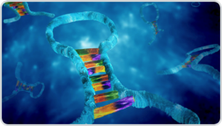
Predefined panels- Comprehensive gene sets
Gene Expression Analysis
Human Cancer Reference panel
Human Inflammation panel
Human Kinase panel
Human Immunology panel
Mouse Inflammation panel
Human Leukemia Fusion panel
Human Angiogenesis virtual panel
Human Apoptosis virtual panel
Human Breast Cancer virtual panel
Human Cell Cycle virtual panel
Human Jak-Stat virtual panel
Human p53 virtual panel
Human Stem Cell virtual panel
Human WNT virtual panel
Mouse Cancer virtual panel
Mouse Stem Cell virtual panel
miRNA Expression Analysis
Human miRNA panel
Mouse miRNA panel
Rat miRNA panel
Drosophila miRNA panel
Copy Number Variation
Human Cancer CN
Human Karyotyping

Slide 14
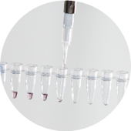
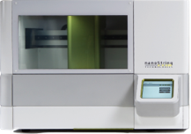
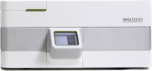

The nCounter Assay workflow: Three Simple Steps
5 min
HANDS-ON
5 min
HANDS-ON
5 min
HANDS-ON
Day 1
Day 2
AUTOMATED
Day 2
AUTOMATED
nCounter Prep Station
nCounter Digital Analyzer
Hybridize
Purify
Count
1
2
3
Only 4 pipetting steps
No amplification
800 genes in single tube
Sensitive
Precise
Quantitative
Simple
Notes:
The protocol could not be more simple.
1) Add buffer, your CodeSet and sample into a strip tube and hybridize overnight.
Load your hybridized samples, the nCounter Prep Plates and the nCounter Sample Cartridge on to the nCounter Prep Station. Everything you need to process the nCounter gene expression assay is provided in a single master kit. This includes all reagents and consumables. Each run processes a single sample cartridge, or 12 samples. This takes about 2.5 hours.
After processing, you transfer your sample cartridge to the nCounter Digital Analyzer for imaging and data collection. The image processing and data collection take about 20 minutes per sample. You can load six cartridges on the analyzer and let it run overnight to process up to 72 samples unattended.
Both the nCounter Prep Station and the nCounter Digital Analyzer have easy-to-use touch screens that walk you through each step of the process.
14

Slide 15










nCounter Assay- Hybridize
Hybridize
CodeSet to RNA
Remove
excess
reporters
Bind
reporter
to surface
Immobilize and align reporter
Image surface
Count codes
mRNA
Capture & Reporter Probes
Notes:
15
To understand the process in more detail, let’s look at the assay from start to finish.
First, you will mix the reporter and capture probes with your RNA. This then hybridizes overnight.

Slide 16








nCounter Assay- Purify
Hybridize
CodeSet to RNA
Remove
excess
reporters
Bind
reporter
to surface
Immobilize and align reporter
Image surface
Count codes
Hybridized mRNA
Excess Reporters
Notes:
16
After the samples are hybridized, all of the sample processing steps are automated on the nCounter Prep Station. The Prep Station uses a magnetic bead purification to isolate only molecules with both a reporter probe and a capture probe hybridized to the same transcript molecule.
This is done by first binding all capture probes, washing away any unbound reporters, then eluting. The process is then repeated, binding all remaining reporter probes, then washing away any unbound capture probes, and eventually eluting.

Slide 17

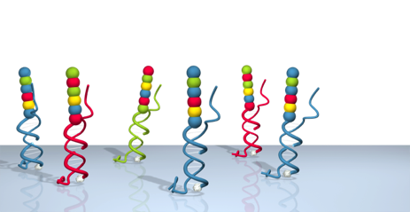
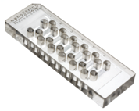
nCounter Assay-Bind
Hybridize
CodeSet to RNA
Remove
excess
reporters
Bind
reporter
to surface
Immobilize and align reporter
Image surface
Count codes
Surface of cartridge is coated with streptavidin
Hybridized Probes Bind to Cartridge
Notes:
17
The purified probe RNA complexes are then bound to a streptavidin surface, via the biotin on the capture probe. Up to millions of probes can be randomly bound to a single lane of the cartridge, depending on the plex and the expression levels of the genes.

Slide 18
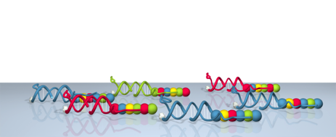
nCounter Assay-Stretch
Hybridize
CodeSet to RNA
Remove
excess
reporters
Bind
reporter
to surface
Immobilize and align reporter
Image surface
Count codes
Notes:
18
In order to image the surface, the reporters must be aligned and stretched out linearly. This is done by applying an electrical charge.
This causes all reporters to stretch to the positive electrode. They are then permanently immobilized, allowing for cartridges to be run at the user’s convenience (up to one month later, though typically imaged immediately after).

Slide 19

nCounter Assay- Count
Hybridize
CodeSet to RNA
Remove
excess
reporters
Bind
reporter
to surface
Immobilize and align reporter
Image surface
Count codes
Image Surface
One coded reporter = 1 mRNA
Notes:
19
The cartridge is then transferred to the Digital analyzer which images the surface of the cartridge. 100s of discrete positions in each lane are imaged, each of which can have hundreds or even thousands of barcodes.

Slide 20
nCounter Assay
Hybridize
CodeSet to RNA
Remove
excess
reporters
Bind
reporter
to surface
Immobilize and align reporter
Image surface
Count codes
Code | Gene | Count
 | x | 3
 | y | 1
 | z | 2
Codes are counted and tabulated
Notes:
20
The Digital Analyzer then performs all image analysis, reads the color combinations, correlates them to the appropriate gene, and tallies how many molecules of each gene are observed.

Slide 21
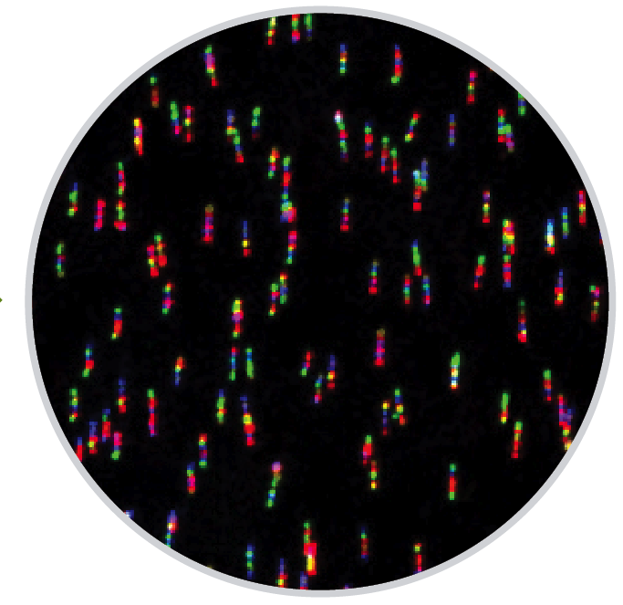
Digital Data Output: One Count = One Read
Assay Number | 1 | 2 | 3 | 4 | 5 | 6
Sample ID | GX1 | GX2 | GX3 | GX4 | GX5 | GX6
Gene Name
POS_A(128) | 28588 | 25747 | 25484 | 26187 | 25443 | 24768
POS_B(32) | 6089 | 5381 | 5963 | 5736 | 5995 | 5564
POS_C(8) | 1408 | 1274 | 1322 | 1302 | 1344 | 1241
POS_D(2) | 480 | 438 | 440 | 482 | 426 | 406
POS_E(0.5) | 77 | 86 | 81 | 59 | 64 | 71
POS_F(0.125) | 38 | 37 | 31 | 38 | 29 | 34
ACTB | 170765 | 71974 | 111725 | 84573 | 191743 | 81607
GUSB | 962 | 426 | 180 | 300 | 524 | 315
RPLP0 | 17844 | 4184 | 5193 | 10499 | 13053 | 6466
PUM1 | 1082 | 234 | 414 | 272 | 710 | 381
Notes:
[8] MESSAGE: Simple looking data ..

Slide 22
Agenda
Platform Introduction
Assay Overview
Performance
Application extensions
  Single cell / small sample profiling
  miRNA
  DNA applications (CNV and ChIP)

Slide 23
The nCounter Assay: Very Reproducible
Reproducibility of NanoString Assay Technical Replicates
R² = 0.9999
Replicate 1 Counts
Replicate 2 Counts
Data Courtesy of Dr. Roger Bumgarner
Notes:
23
23
Of course, the easiest way to show precision and reproducibility is to show technical replicates
Same RNA
Different hybridizations
500 plex
Very high precision

Slide 24
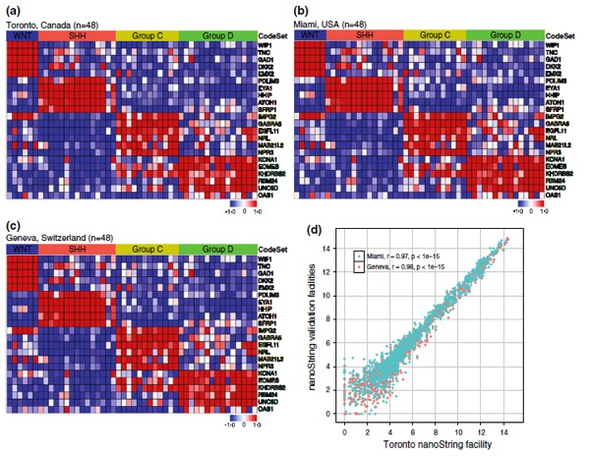
The nCounter Assay: Very Reproducible
Rapid, reliable, and reproducible molecular sub-grouping of clinical medulloblastoma samples
Northcott P.E. et al., Acta Neuropathologica; November 16, 2011
Site 1
Site 2
“We present an assay based on NanoString technology that is capable of rapidly, reliably, and reproducibly assigning clinical FFPE medulloblastoma samples to their molecular subgroup, and which is highly suited for future medulloblastoma clinical trials.”
Site 3
R² Site1 v Site 2 = 0.97
R² Site1 v Site 3 = 0.98
Notes:
A more rigorous way of looking at assay performance is to have three independent labs run the same codeset on the same samples. As you can see, the results are virtually indistinguishable. This demonstrates that the assay is robust, regardless of instrument, user, etc…

Slide 25
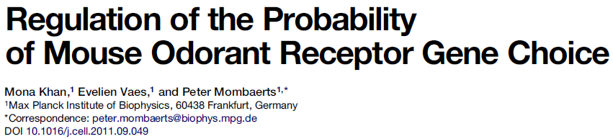

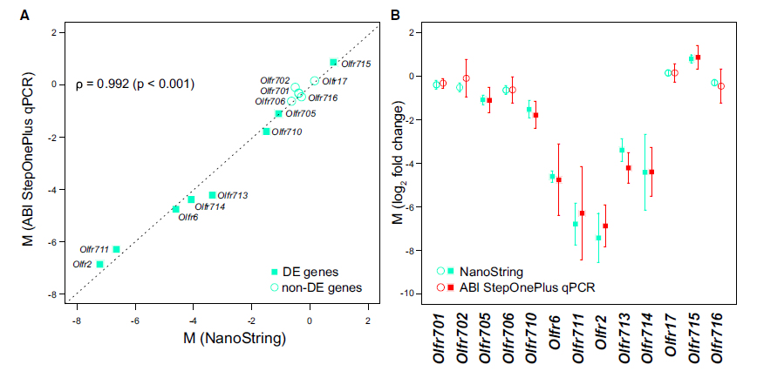
Agrees with qPCR, more precise
Khan et al., 2011
Notes:
Of course, many times people want to compare to legacy technologies such as qPCR.
On the left is a comparisons of the deltaCt values by qPCR (Y axis) vs the log2 NanoString counts (x Axis). As you can see, NanoString’s data is highly concordant, even in complicated gene sets such as Odorant Receptors.
The main difference is precision. On the right, you can see technical replicates being run of each gene on both NanoString and qPCR. In blue, you can see that the error bars are far tighter in almost all cases by NanoString vs qPCR. This speaks to the high degree of precision from the nCounter assay.

Slide 26
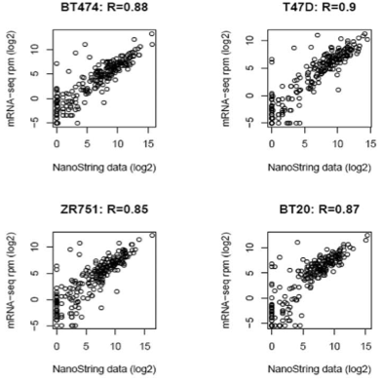
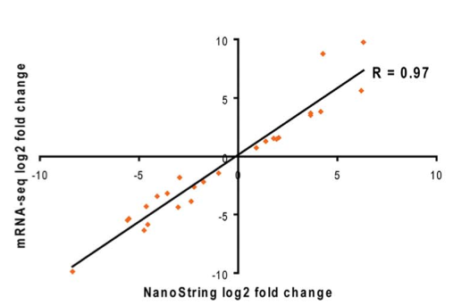

Agrees with RNA-seq fold changes
Sun et al. Integrated analysis of Gene Expression, CpG Island Methylation, and Gene Copy Number in Breast Cancer Cells by Deep Sequencing. PLoSone, Feb, 2011
Notes:
Finally, the nCounter has a high degree of agreement with RNA sequencing.
In this paper, done by the Mayo Clinic in Jacksonville FL, in conjunction with Illumina, individual RPKM (reads per million, normalized to the length in KB of the transcript) of genes counted by RNAseq were compared to counts on the nCounter system. As you can see on the left, the individual biases introduced by library prep, amongst other potential sources can be seen, though overall raw correlation is pretty good. When expressed on a fold change level on the right however, these biases cancel out and the correlation is very good, as you would expect.
The key message here is that both RNAseq and NanoString are very good technologies, but for projects where specific pathways or gene sets need to be profiled, the nCounter is a much simpler, more cost effective method, providing equal or better data quality.

Slide 27

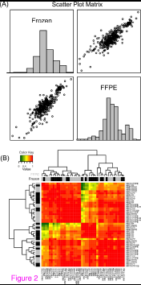
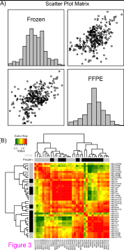
FFPE Performance: Nanostring Vs qPCR
Nanostring
SYBR qPCR
19 frozen vs 19
FFPE oral carcinomas
19 frozen vs 19
FFPE oral carcinomas
Correlation coefficient
R=0.90
Correlation coefficient
R=0.50
Reis et al., 2011
Notes:
A very significant portion of all work done on the nCounter platform is with FFPE samples. This is because it has the best performance of any platform we’ve ever come across with FFPE samples.
This group had a very rare sample set, in that they had paired fresh and FFPE oral carcinoma samples. This signature was developed using fresh RNA on Affymetrix arrays, then transferred to qPCR. The problem arose when attempting to then validate the signature in FFPE samples. As you can see on the right, the correlation between fresh and FFPE was 0.5. When the group generated a NanoString codeset to the same gene set, the correlation went to 0.9, and the power of the signaure returned.
The reason for the better performance is the lack of enzymatic steps. FFPE is notoriously diffivcult to reverse transcribe, never mind amplify. By using a non-enzymatic approach, these issues disappear.

Slide 28
PaxGene Blood Lysates vs. Purified RNA
Good correlation between PaxGene blood RNA and Lysate
log2 counts from blood lysate
log2 counts from total RNA purified from blood
Notes:
And of course, we can do the same thing with a lysed cell pellet from PaxGene blood.

Slide 29
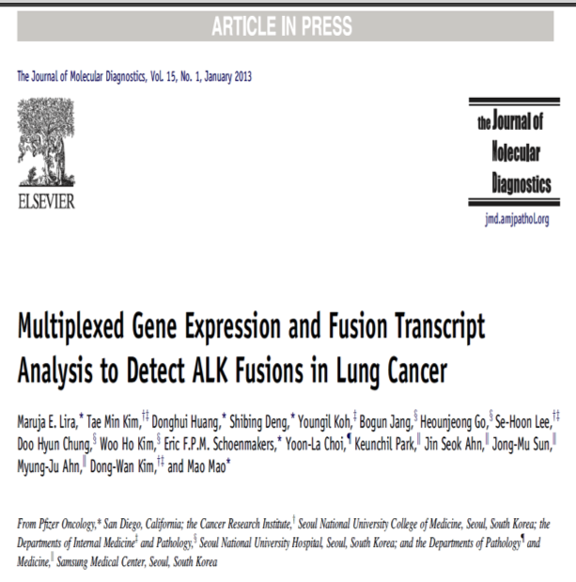
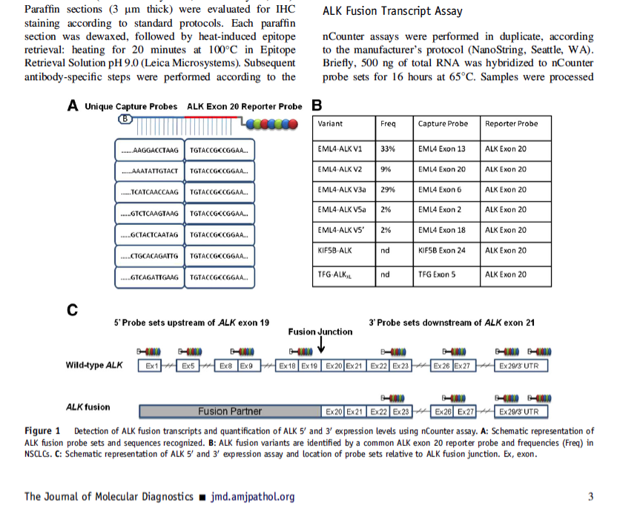
Digital Gene Fusion Quantitation using NanoString Technology
(Lira et al, Journal of Molecular Diagnostics 15 (1) Jan 2013)

Slide 30
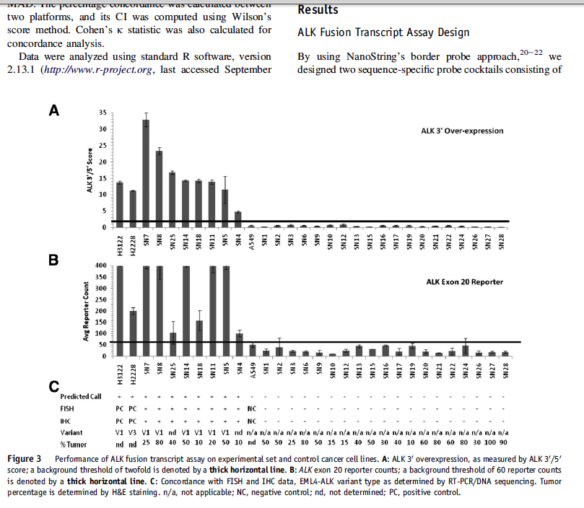
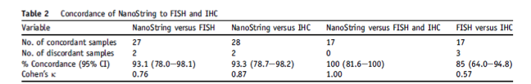
The results: NanoString’s digital gene-fusion detection technology works in difficult real-world samples
Elevated 3’-probe digital counts over over 5’- digital counts: positive signal for gene-fusion (normal below horizontal bar)
Information complementary to existing FISH assay
ALK general expression over back ground (normal below horizontal bar)
Information complementary to existing IHC assay
%-tumor ranges from 10% to 100%
2-discordances measured. Both were non-responders (to therapy). Authors state “…suggest FISH false-positive results”
(Lira et al, Journal of Molecular Diagnostics 15 (1) Jan 2013)

Slide 31
Agenda
Platform Introduction
Assay Overview
Performance
Application extensions
  Single cell / small sample profiling
  miRNA
  DNA applications (CNV and ChIP)

Slide 32
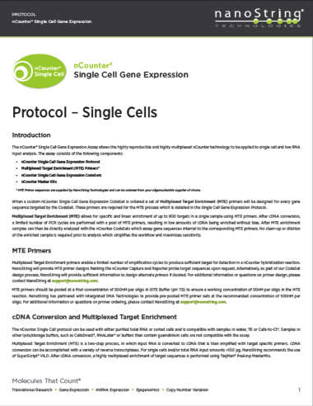
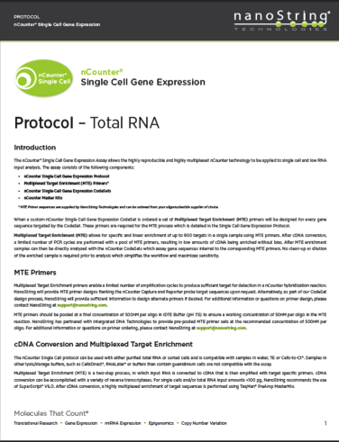
Single Cell Application Allows Input Down to 1 Cell (or 10pg RNA)
Notes:
By single cell, we’re not always talking about individual cells (though it certainly can be). We have optimized protocols for very low amounts of extracted RNA (down to 10pg) as well as individually sorted cells.

Slide 33
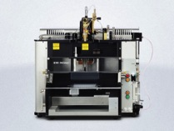
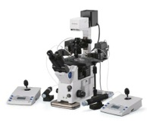
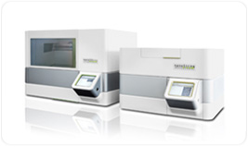
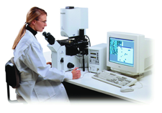
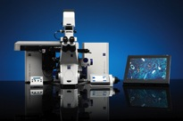
nCounter Compatible with a Range of Single Cell Prep Methods
nCounter Gene Expression
Single-Cell
MicroManipulation
Fluorescence Activated Cell Sorting (FACS)
Completely Digital
Robust and Automated
Multiplexed (up to 800-genes)
Laser Capture Micro Dissection (LCM)
Optical Tweezers
Notes:
The system is of course very open to cells derived from any number of sources, though FACS is clearly the most common. Essentially anything which can deposit a cell into a well of a 96 well plate will work.

Slide 34


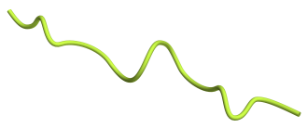
Multiplexed Target Enrichment Primer Design
Target-specific primers designed to amplify NanoString Probe target region
Forward
Primer
Probe Target Region
Reverse
Primer
Primers designed using Primer3
  Consistent amplicon size range 170-230nt (200 average size)
  Optimal primer size = 18nt
  Optimal primer Tm = 60ºC
Notes:
The idea is that we will be doing a multiplex amplification of up to 800 genes at once. We can either design primer sequences at no charge when we design custom probes, or you are free to design them yourselves.
Note, we are breaking our no amplification mantra, but we’re doing so because we have to, not because we want to. The difference is that we do a single round of 14-17 cycles of PCR, then go straight to our digital detection methodology. There is no amplification of amplification products.

Slide 35
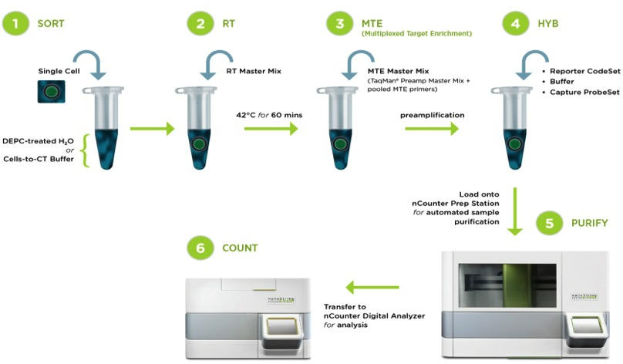
Single Cell Workflow: Single Cell → Single Tube → 800 Genes
Notes:
The protocol is simple.
Lyse cells
Add RT mix and RT
Add MTE (Multiplex Target Enrichment- PCR preamp mix) and primers and amplify 14-17 cycles
Add codeset and hyb
Run standard assay.
Note, at no point are we splitting samples- It’s always additive.

Slide 36
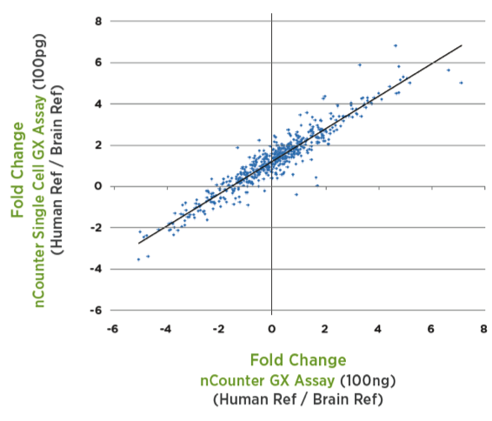
High correlation across 800 genes
R² = 0.9
Notes:
Fold change comparison of preamped (100pg of RNA) vs non-preamped (100ng of RNA) sample across 800 genes.

Slide 37
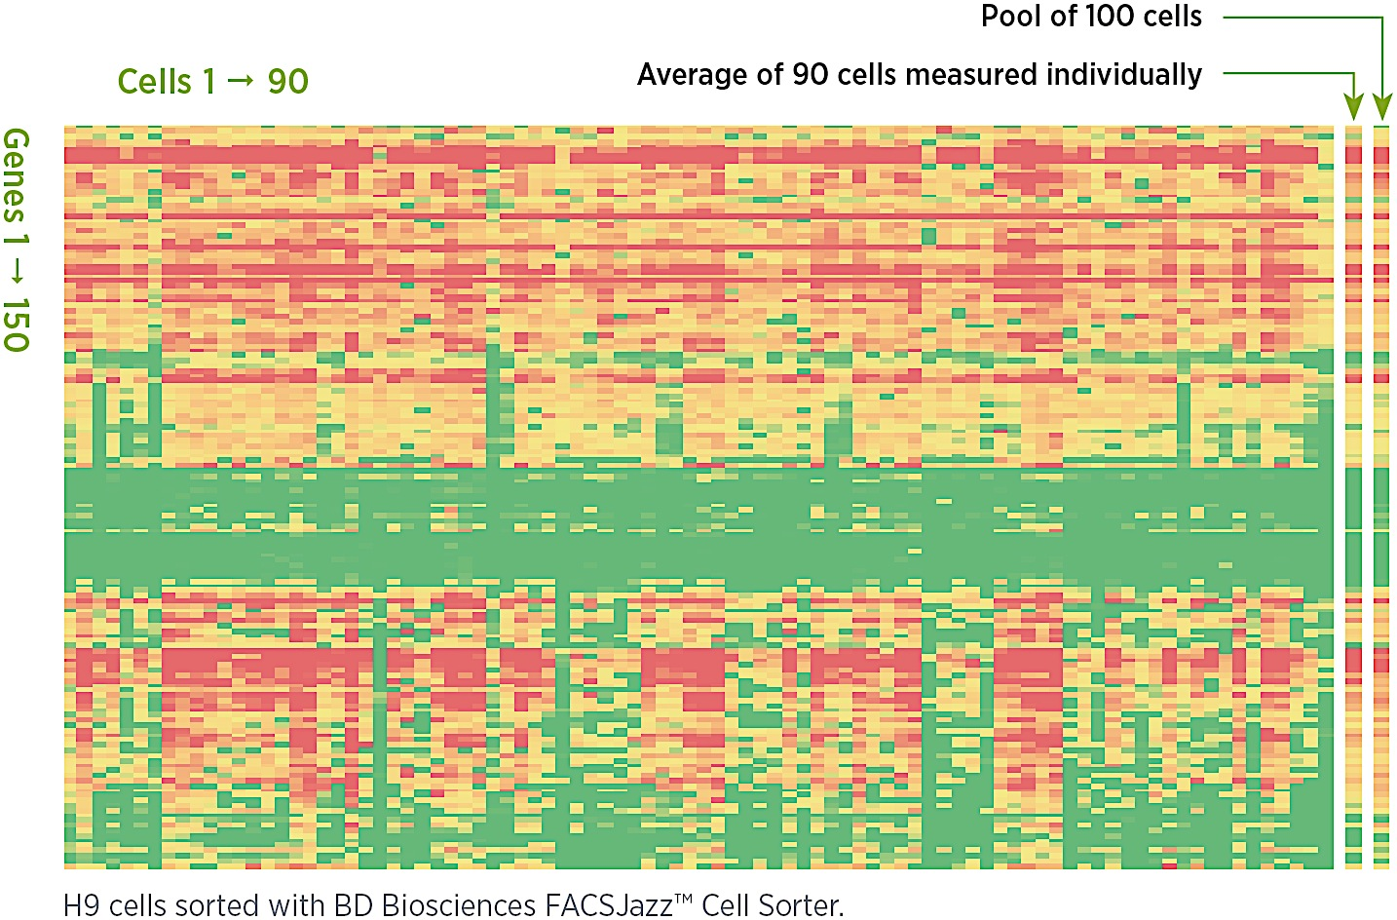
NanoString Single-Cell Technology clearly reveals gene-expression on-off “bursts” and digitally-quantitative multi-cell averaging behavior
The nCounter system is a digital technology which displays excellent reproducibility and linearity, as evidenced by the very close matching of the averaged single-cell profiles versus the physically sorted multi-cell profile.
Notes:
Single cell gene expression from cells sorted on a BD FACS Jazz system. Note the diversity of expression across a theoretically homogeneous cell population.
Also note that the average of each of the 90 Individual cells looks almost identical to a pool of 100 cells on the right.

Slide 38
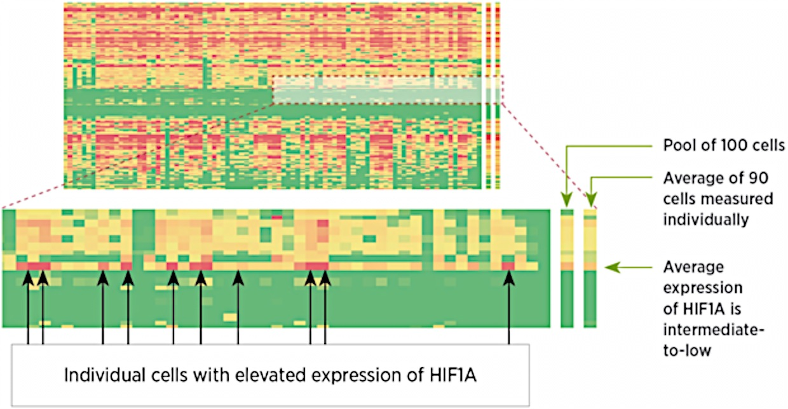
Single-Cell Biology: individual cells ≠ average. Can’t always predict interesting single-cell genes from the high-cell # average gene behavior
High transcript multiplexing of up to 800 genes may be crucial to obtaining biological understanding, as all pairwise gene-correlations must be calculated from a single cell
High transcript multiplexing allows researchers to more easily discover unanticipated single-cell gene behavior
Data highlights the power of Single Cell analysis to identify potentially important genes for further analysis
AND
the importance of including a comprehensive set of genes in Single Cell experiments, as genes with unremarkable expression profiles in prior pooled analysis could be important
Notes:
Point out that we are looking at a blow-up of a small region of the data shown on previous slide (upper)
Note that NanoString has discovered-found that there is a subset of incredibly interesting genes (in this case gene HIF1A) that have a unique phenotype of --- although the average gene expression of HIF1A is NOT very interesting, it is very highly expressed (red-cells) in ~ 5% of the cells. This 5% high-expressors completely disappear when you average over many cells. We believe that genes such as HIF1A are going to be key to understanding things like “tumor stem cells”, and (perhaps) driver mutations that may only be very briefly turned-on at any given time.

Slide 39
Agenda
Platform Introduction
Assay Overview
Performance
Application extensions
  Single cell / small sample profiling
  miRNA
  DNA applications (CNV and ChIP)

Slide 40

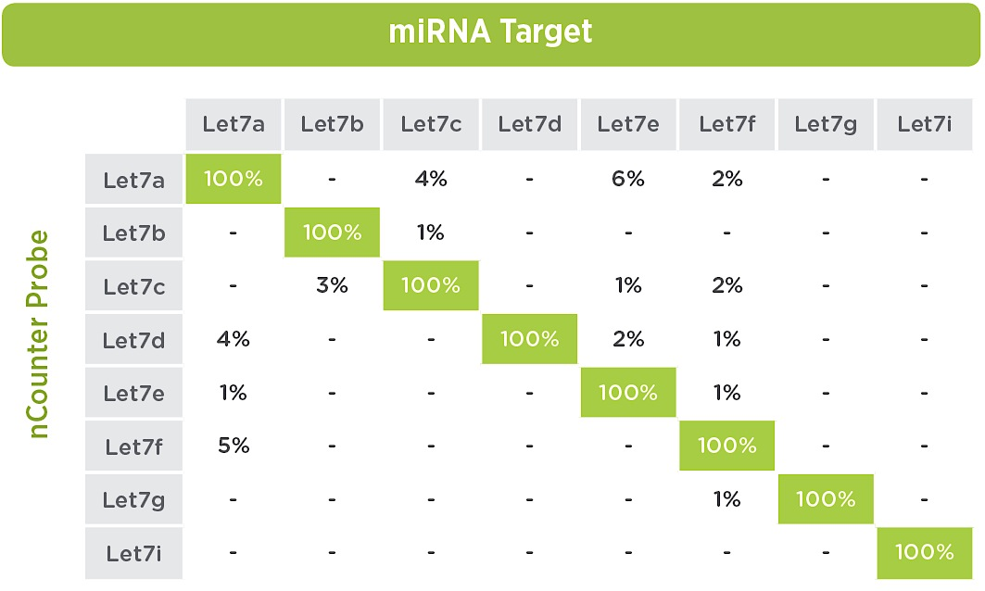

nCounter miRNA Analysis
High precision amongst closely related family members
nCounter®
miRNA Analysis
Profile up to 800 miRNAs in one reaction
Premade panels for human, mouse, rat and drosophila
Customized panels
  miRGE: Detect miRNA and mRNA in same sample
  A la carte: subsets of miRNAs
High level of sensitivity, specificity, precision, and linearity
let 7a ugagguaguagguuguauaguu
let 7b ----------------g-g---
let 7c ------------------g---
let 7d a--------------c------
let 7e --------g-------------
let 7f -----------a----------
let 7g -----------u----------
let 7i -----------u----gcu---
Notes:
The nCounter assay can also be used to profile miRNA. The assay provides a unique combination of specificity, high multiplex, precision, and accuracy unique across mirNA platforms. Panels exist for multiple species, but can also be customized into more focussed panels.
Unique to NanoString is the ability to profile up to 30 miRNAs and 200 mRNAs in a single assay- Very important for complex signatures and understanding miRNA’s role in pathways.
Discuss the let 7 family, and it’s high homology across family members. Typically when there is only 1 base difference, we still only see a few % (6% worst case) cross hyb potential. Actually new data about to be published shows we may be conservative in how we’re calling cross reactivity, and the reality is probably even less.

Slide 41

Challenges To miRNA Detection- Sequence Tm diversity
Short length
  overall low Tm
  prohibits concurrent binding, e.g. nCounter dual probe
  NanoString’s Tag Ligation assay overcoms this problem
Large sequence diversity
  leads to large Tm spread even though length distribution is fairly small
  NanoString overcomes this by using targeted sequences to normalize Tm variability.

Slide 42

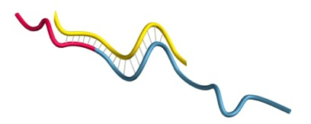


NanoString miRNA Assay Workflow
1) Bridge oligo specifically anneals to each miRNA target
2) Unique miRtag for each miRNA species
3) miRNA is covalently linked to miRtag via ligation
4) Excess bridges and tags are removed
5) Detect using standard NanoString Chemistry
Notes:
Explain workflow…

Slide 43
miRNA Profiling with the nCounter system – Sample Amount
Good correlation between counts and amount of RNA used in the reaction (Top 100 expressing shown)
Correlation between 400ng and:
300ng | 0.9966
200ng | 0.9950
150ng | 0.9953
100ng | 0.9919
50ng | 0.9660
Notes:
Like all of our assays, the results are very linear, depending on input amount. What’s important here, is when looking at dynamic range of miRNA expression it’s quite wide. Here we’re showing a linear range from 2^5 counts to 2^19 counts. This is limited by biology, and not the platform. We can see individual miRNAs over 1 million counts…
43

Slide 44

Dynamic range of the miRNA assay
Notes:
A comparison of skeletal muscle vs heart muscle. Closely related tissues, but some expression differences. Also note miR-1 in the upper right. miR-1 is very muscle specific.

Slide 45

Dynamic range of the miRNA assay
hsa-miR-1 expression in different tissues
Notes:
Tissue-specific detection of a muscle-specific miRNA, mir-1. Note that the expression ranges from nondetectable in many tissues to hundreds of thousands of counts.

Slide 46

miRGE assay- Profile miRNA and mRNA in the same tube
Research Topic | Number of miRNAs Studied | Number of mRNAs Studied | Source
Melanoma | 24 – Primary Tumors 29 – Metastatic Tumors | 61 | Philippidou et al
Neuronal Differentiation | 6 | 97-125 | Minh et al
Lung Cancer | 15 | 30 | Raponi et al
Pediatric Malignancies | 14 | 28 | Wei et al
Breast Cancer | 11 | 0 (14 mentioned) | Iorio et al
Cancer (15 types) | 3-12 (depending on type of cancer) | 0 | Heneghan et al
Cancer Tissue of Origin (24 tissues) | 48 | 0 | Rosenfeld et al
~60% of transcripts regulated by microRNAs
MicroRNAs (miRNAs) modify gene expression patterns transcriptionally and post-transcriptionally
One miRNA can regulate many genes
Multiple miRNAs can regulate the same gene
Aberrant expression of small numbers of miRNAs can have a wide impact on global gene expression
Involved in many pathways and processes
Cell proliferation
Cell differentiation
Metabolism
Apoptosis
Oncogenesis
Immunology and inflamation
Notes:
Focused co-profiling studies are becoming more and more important
miRNAs and their downsteam targets have been pinpointed as reliable disease specific biomarkers
Understanding mechanisms for gene regulation in specific disease involves studying multiple levels of expression
Moving from miRNA discovery to miRNA functional studies requires co-profiling, often in larger study sizes than in discovery along (hence the need for easier workflow)

Slide 47
miRGE
Notes:
I should find a better miRGE slide… This one is FFPE vs fresh.
47

Slide 48
Agenda
Platform Introduction
Assay Overview
Performance
Application extensions
  Single cell / small sample profiling
  miRNA
  DNA applications (CNV and ChIP)

Slide 49













nCounter Copy Number Assay
Perform nCounter Hybridization
Genomic DNA
Fragment ds genomic DNA using 4 base cutter (Alu 1)
Average~ 500 bases
Denature DNA @ 95°C
49
NanoString Confidential.
Notes:
Prior to hybridization, genomic DNA is fragmented and denatured. After that, the hybridization steps are the same as for other nCounter assays.

Slide 50

Linearity and precision of nCounter assay
Profiled 1, 2, 3, 4 and 5 X chromosomes
The accuracy (measured vs. expected values) obtained with the nCounter system is extremely high
The 5 copy cell line is actually mosaic mixture of 4 and 5 copies
Notes:
Interesting story- We procured cell lines with variable numbers of x chromosomes, 1-5. As you can see, all line up with their appropriate copy number except the 5 copy cell line. This was concerning…
We checked with the vendor who confirmed by karyotyping that the cell line was in fact mosaic 4 and 5 copies. No one had ever noticed previously…

Slide 51

CNV Calls are Reproducible and Precise
Affy6_12
Affy6_31
Probe 1
Probe 2
Probe 3
Notes:
Of course, miltiple probes designed to the same gene regions will behave consistently

Slide 52

Calls agree with HapMap
One copy
No copies
No copies
HapMap CNV
nCounter CNV
Notes:
And the calls agree well with the hapmap data

Slide 53


nCounter CNV Analysis
Multi-site concordance
nCounter®
CNV Analysis
R = 0.91
R = 0.99
Better, faster results with less effort than PCR or arrays
Lowest hands-on time of any platform
Profile up to 800 regions of the human genome in a single reaction
Superior reproducibility
Notes:
But importanty, the reproducibility, especially across sites is much higher with NanoString than arrays (Affy in this case). This lab (harvard) both ran the platforms and sent the same samples to the vendors to run in their own labs. As you can see, the reproducibility os much better on NanoString. This is likely because of the variability introduced during the labelling and array hybridization process.

Slide 54
ChIP-String: accurate enrichment data
Ram O. et al, 2011, Cell
Notes:
Of course, there is nothing particular to CNV analysis. ChIP is another application which can be done on the platform. The beauty of ChIP is that the samples are so enriched that we can directly detect ~5ng of ChIP’d DNA without amplification

Slide 55
In conclusion…
Flexible platform for multiple applications
  Gene Expression
  miRNA profiling
  DNA (CNV or ChIP) detection
  Single Cell profiling
  Gene Fusion Analysis
High concordance with qPCR, microarrays, and RNA-seq
Unparalleled precision
Simple platform- No need for dedicated personnel
NanoString is highly customizable
  20-800 genes
  10s to 1000s of samples

Slide 56


Thank You!
Molecules That CountTM
Paul Rasmussen
prasmussen@nanostring.com
Notes:
56

